Slide 1
CMPE 220
Class 27 – Mobile Operating Systems
Notes:
Let’s talk about history.
California State Railroad Museum – 1976 - docents worked on original steam engines.

Slide 2
Types of Operating Systems
Batch / Single-Process (early computers – 1940s-50s)
Multi-Programming Systems (“modern” computers – last 1960s)
Multi-Processor Systems
Distributed Operating Systems
Network Operating Systems
Embedded Systems
Real-Time Systems
Cloud Systems
Mobile Systems

Slide 3
What is a Mobile Operating System?
An operating system for smartphones, tablets, smartwatches, smartglasses, or other non-laptop personal mobile computing devices
Mobile operating systems combine features of a desktop computer operating system with other features useful for mobile or handheld use

Slide 4
Popularity of Mobile Operating Systems
An estimated 6.84 billion mobile phones in use
Compare to:
2.5 billion computers (desktops, servers, laptops)
Windows
MacOS
Linux (multiple variants)
Cloud Operating Systems
15.2 IoT devices
Linux
Dozens of dedicated operating systems

Slide 5
Mobile Operating Systems Market Share
Q1 2023 | Worldwide Market Share
Android* | 71%
iOS | 29%
All others (combined): Windows Symbian Ubuntu | < 1%
* Android Variants
Each manufacturer produces their own customized version of Android
Mostly variations in User Interface and pre-loaded apps

Slide 6
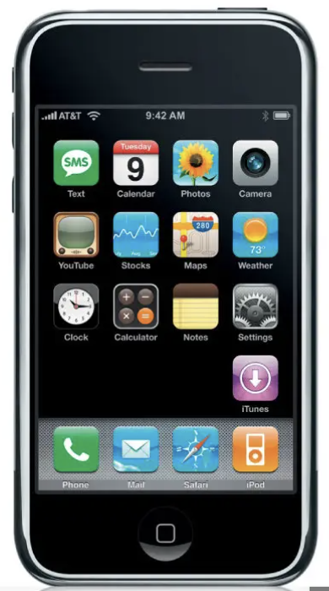
History: iOS
First released by Apple Computer in June 2007
Based on BSD Unix
Originally called iPhone OS
Renamed iOS (version 4) in April 2010 to expand support to iPad

Slide 7
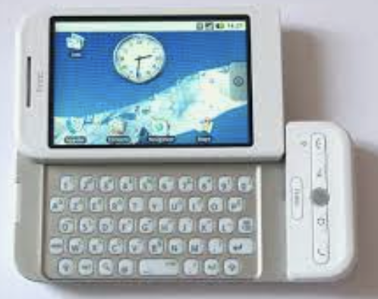
History: Android
Developed in 2003 by Android, Inc. as an operating system for cameras
Based on Linux
Purchased by Google in 2005
First Android-based phone - the HTC Dream - shipped in September, 2008

Slide 8
Is Android Open Source?
The core OS is developed and released by the Android Open Source Project – through a consortium managed by Google
Most of the Android application software is not open source
Most code comes from Google
Google licenses its own version to hardware vendors
Amazon Kindle operating system – FireOS - is based on the Android Open Source Project

Slide 9
The Android OS Release Pipeline
New version of Android is “frozen” in open source
Google releases a new version of its proprietary Android with Google apps
Manufacturers “port” the system to their hardware
Manufacturers release the new version
Typical delay: several weeks to several months
Major releases take longer
Security risk!

Slide 10
Update Rates
Good statistics are hard to find, but iOS users are much more likely to be running the “current” OS
An estimated 60% or more of iPhone users are up-to-date
Less than 20% of Android users are up-to-date
Android Version | Market Share
13 | 12%
12 | 17%
11 | 23%
Older | 49%
iOS Version | Market Share
16 | 61%
15 | 28%
14 | 3%
Older | 8%

Slide 11
Problems Due to Slow Adoption
Security Risks
Hackers target known vulnerabilities
Slow feature adoption
App vendors don’t take advantage of new features

Slide 12
Comparison of Operating Systems
All provide a means of sharing resources across a communications network
Network Operating System: access to remote resources is explicit
Distributed Operating System: access to remote resources is implicit – programs may not know about locality of references
Cloud Operating system: manages the operation, execution and processes of virtual machines, virtual servers and virtual infrastructure, as well as the back-end hardware and software resources.

Slide 13
Mobile OS Differences

Slide 14
File System
Mass Storage
No disk drive
Solid-state storage (file system)
System doesn’t need to deal with disk latency
Supports virtual memory
RAM: 4-16 GB
Mass Storage: 16GB – 1TB

Slide 15
Networking: OSI Versus TCP/IP Models
OSI Reference Model
TCP/IP Model
OSI model provides a clear distinction between application, presentation, and session services.
TCP/IP groups these as a single Application layer
In the OSI model, the data link layer and physical are separate layers.
TCP/IP groups these as a single Network layer
Application
Application
Presentation
Session
Transport
Transport
Network
Internet
Data Link
Network
Physical

Slide 16
Networking
Layer | Smartphone Implementation
Application | HTTP, HTTPS, POP, IMAP, SMTP, SMS, etc
Transport | UDP, TCP
Internet | IP
Network | Wifi Cellular

Slide 17
I/O
Device I/O: keyboards, printers, etc
Drivers:
Bluetooth
USB
Camera
Audio input & output
Location services
Touchscreen

Slide 18
User Interface
Screen interface / Window system
User Interface API
Event-driven framework

Slide 19
Power Management
Charging
Smart charging algorithms
Charge monitoring
CPU throttling (Apple “scandal”)
Task management
Instruction selection
Battery monitoring
Health assessment and reporting

Slide 20
Additional Characteristics
Resiliency and Availability - the ability of a service to recover quickly from any disruption
Critical Phone Service – service disruptions can be life-threatening

Slide 21
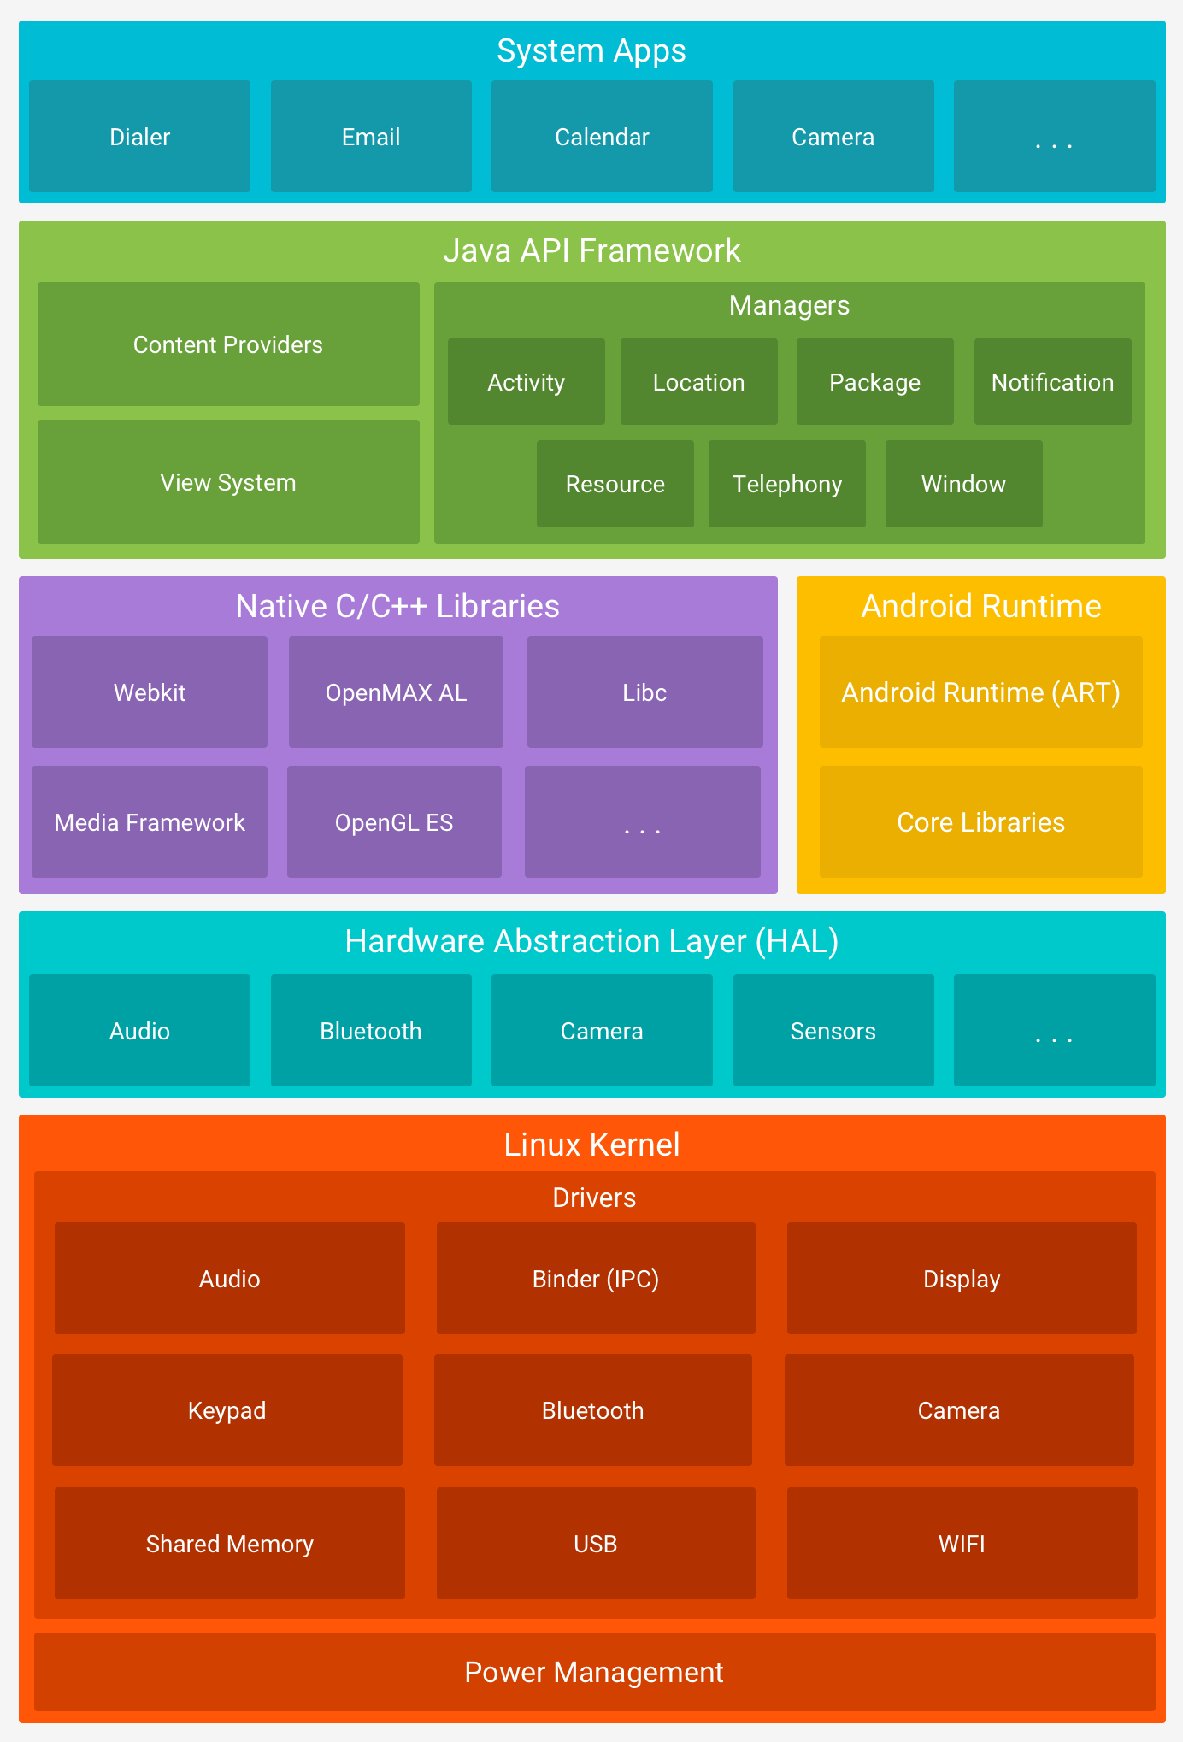
Android Architecture
Linux based
C/C++ OS Code
Java Virtual Machine
Application Framework

Slide 22
Development
Android SDK
Java Virtual Machine (JVM)
Multiple application frameworks
Applications can be written in Kotlin, Java, and C++
Kotlin is a modern, statically-typed language used by over 60% of Android developers

Slide 23
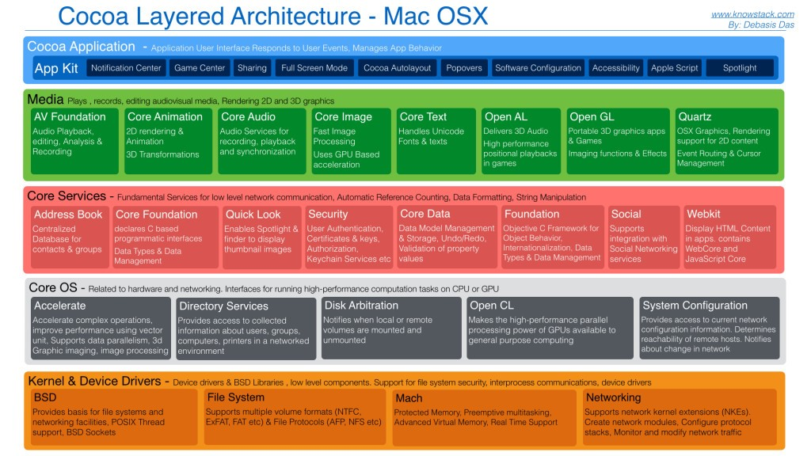
iOS Architecture
Based on BSD-Unix

Slide 24
Development
An object-oriented application framework
Cocoa for iOS and MacOS
Cocoa is written in Objective-C, C++, and C
Applications are written in Swift and Objective C

Slide 25
Security
Android is an open system
Applications may be distributed through the Google Play Store or private exchanges
Google inspects and verifies applications in Play Store
iOS is a closed system
Applications must be distributed through the Apple Store
Apple inspects and verifies apps in App Store
Security Implications
Theft of data

Slide 26
Estimated Prevalence of Malware
Android: 0.25% to 4% of devices may have malware
Apple: < 0.05% of devices may have malware
In 2017, Nokia’s 2017 Threat Intelligence Report revealed that:
68 percent of all mobile devices infected with malware in the past year were running Android
28 percent were running Microsoft Windows
3 percent were running iOS

Slide 27
Privacy
Apple restricts application tracking
Apps must ask users before tracking and reporting usage
Apple enforces tracking restrictions through the App Store
Google currently has no restrictions on tracking
Restrictions – if any – cannot be enforced

Slide 28
Anti-malware
Major vendors support aps on both Android and iOS
BitDefender
McAfee
Norton
SmartCleaner

